Slide 1
WORLD CUP 2022 COMPARATIVE ANALYSIS:
VISSUALIZATION

Slide 2
Agenda
Best teams from each continent
Best attacking teams
Best defensive teams
Best midfield teams
Comparison of the finalists:
Touches
Take-Ons
Carries
Overall best team

Slide 3

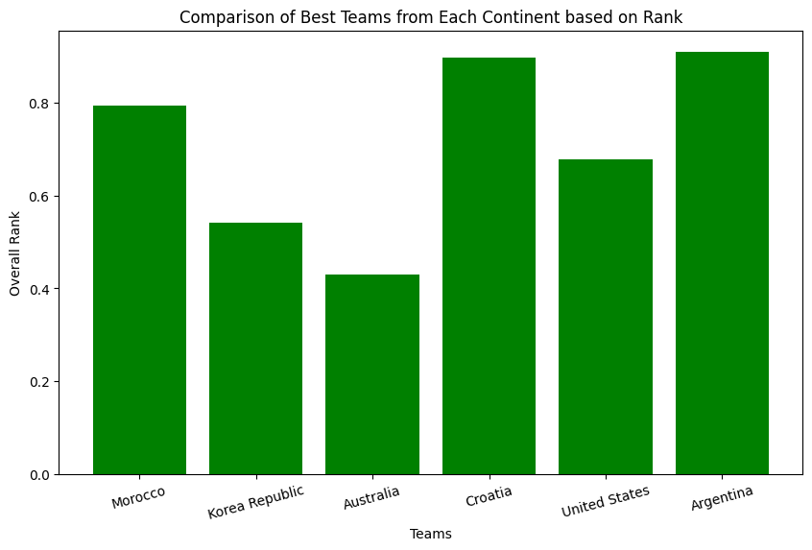
Best teams from each continent

Slide 4
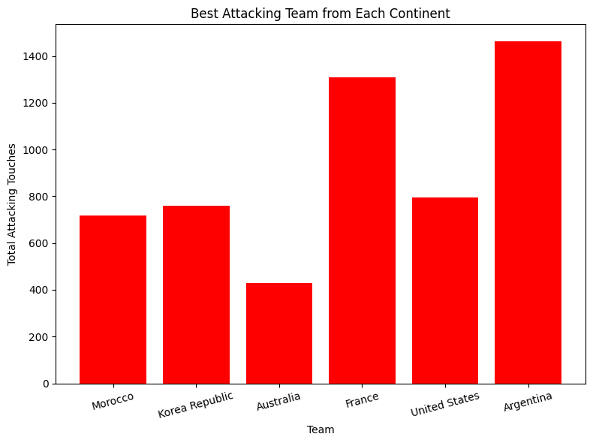
Best attacking teams

Slide 5
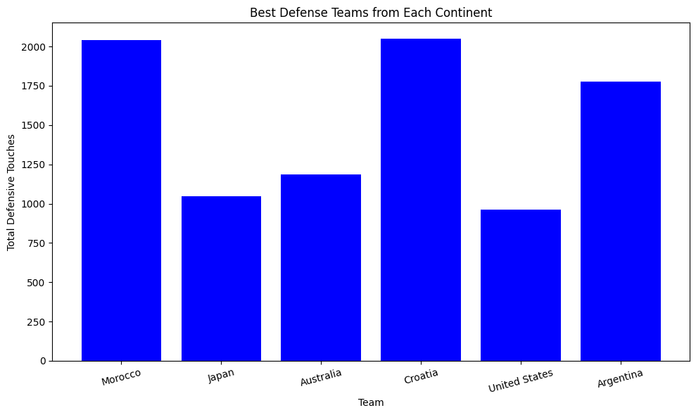
Best defensive teams

Slide 6
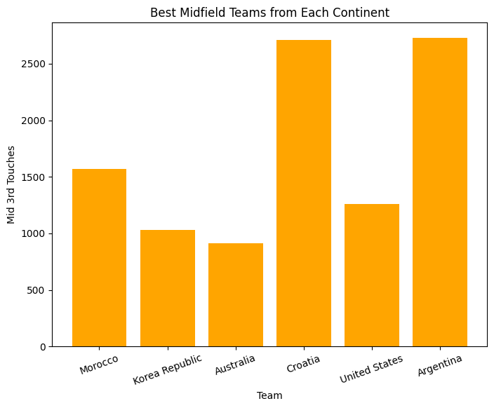
Best midfield teams

Slide 7
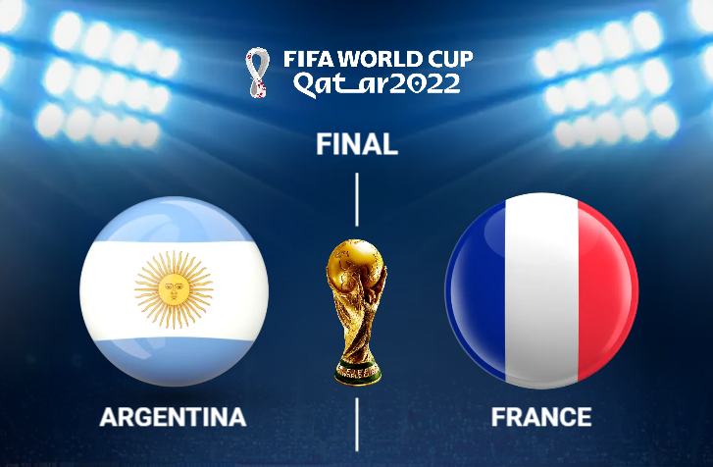
Comparing the finalists of 2022 Fifa World cup

Slide 8
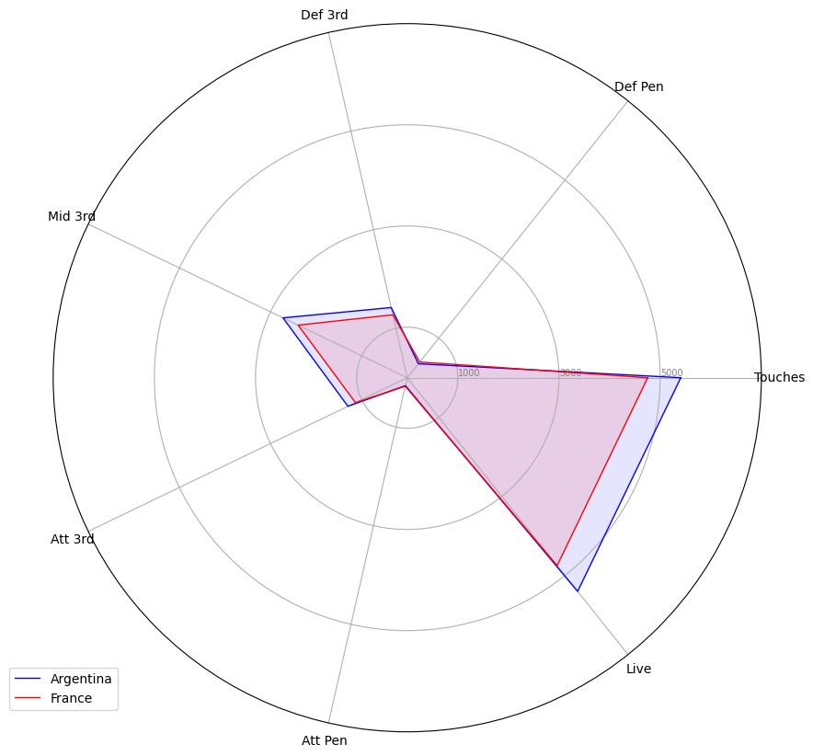
Finalists on touches

Slide 9
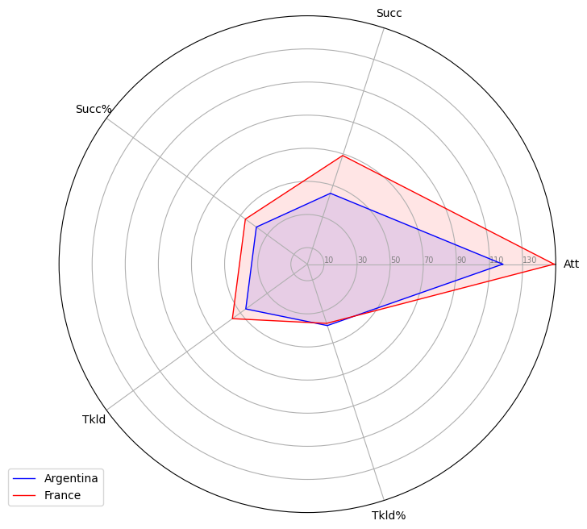
Finalists on take-ons

Slide 10
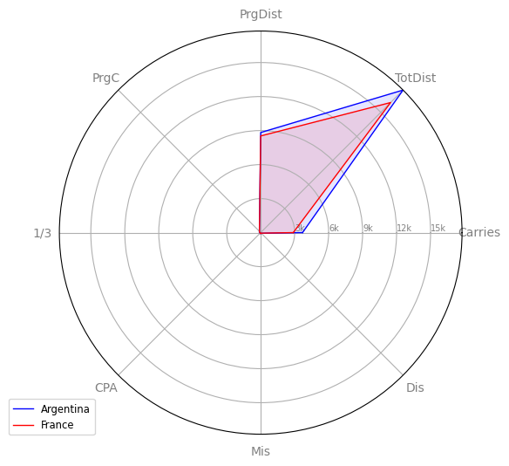
Finalists on carries

Slide 11
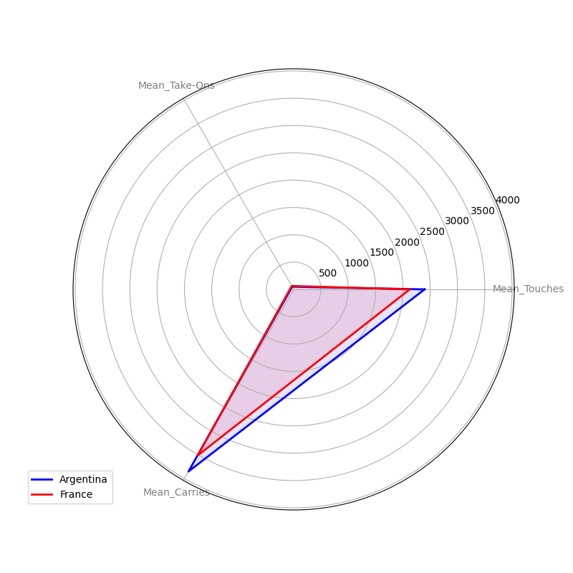
Overall best
The overall comparison based on Touches, Carries and Take-Ons mean attributes for the two finalist suggest that while France demonstrates strength in Take-Ons, Argentina has an edge over France in both Touches and Carries suggesting good ball possession and control under pressure making it the best team overall based on these three aspects.

Slide 12
THANK YOU

